Slide 1



INFO 6150
FINAL PROJECT
HUSKY DEVELOPERS PORTAL
PRESENTED BY: SONALI SINGH
SANYUKTHA KUMBLA
NEHA BATTULA
DEEP VAIDYA

Slide 2
PURPOSE
The reliability on social media to seek ideas and feedback while building applications has increased to great folds.
Therefore, we wanted to create a platform for talented developers to showcase their skills and provide innovative solutions through their problem-solving ability.
Our website implements features like creating a post based on their skills and caters to commenting and liking posts created by other developers using our portal, sending an email verification on sign up, displaying developers nearby based on their current location, displaying graphs for analyzing developers’ performance based on skills, likes, and comments thereby assigning badges to them, displaying GitHub repos of the developer, and filtering developers based on their skills.

Slide 3
FEATURES EXPLORED
Used Redux to maintain state
JSON web token for safely authenticating the user to explore various functionalities of our website
Implemented crypto library for hashing passwords
Displaying the profile image of a developer using Gravatar library
Analyzing developers’ performance based on various metrics using ChartJS library
Displaying GitHub repositories of a developer using GitHub API
Connected to MongoDB using mongoose
Plotting nearby developers’ location on map using react-leaflet and GeoJSON API

Slide 4

APIs IMPLEMENTED
GeoJSON API
CharJS package
Gravatar library
NodeMailer module
GitHub API

Slide 5
CONTRIBUTIONS
SONALI SINGH: Crypto, CHARTJS, JWT, NODE-MAILER, Gravatar
SANYUKTHA KUMBLA: REDUX, REACT-LEAFLET, ChartJS
NEHA BATTULA: NODE- MAILER, GITHUB API, REACT-LEAFLET ,GeoJSON
DEEP VAIDYA: REDUX, GITHUB API, Crypto, GeoJSON, Gravatar
ALL OF US HAVE CONTRIBUTED TO IMPLEMENTING REACT COMPONENTS, PAGES, AND CONTROLLERS.

Slide 6
REFERENCES
https://www.w3schools.com/nodejs/nodejs_email.asp
https://mongoosejs.com/docs/geojson.html
https://react-leaflet.js.org/docs/example-map-placeholder
https://www.loginradius.com/blog/async/github-api/
https://www.chartjs.org/docs/latest/general/data-structures.html
Using the State Hook – React (reactjs.org)

Slide 7
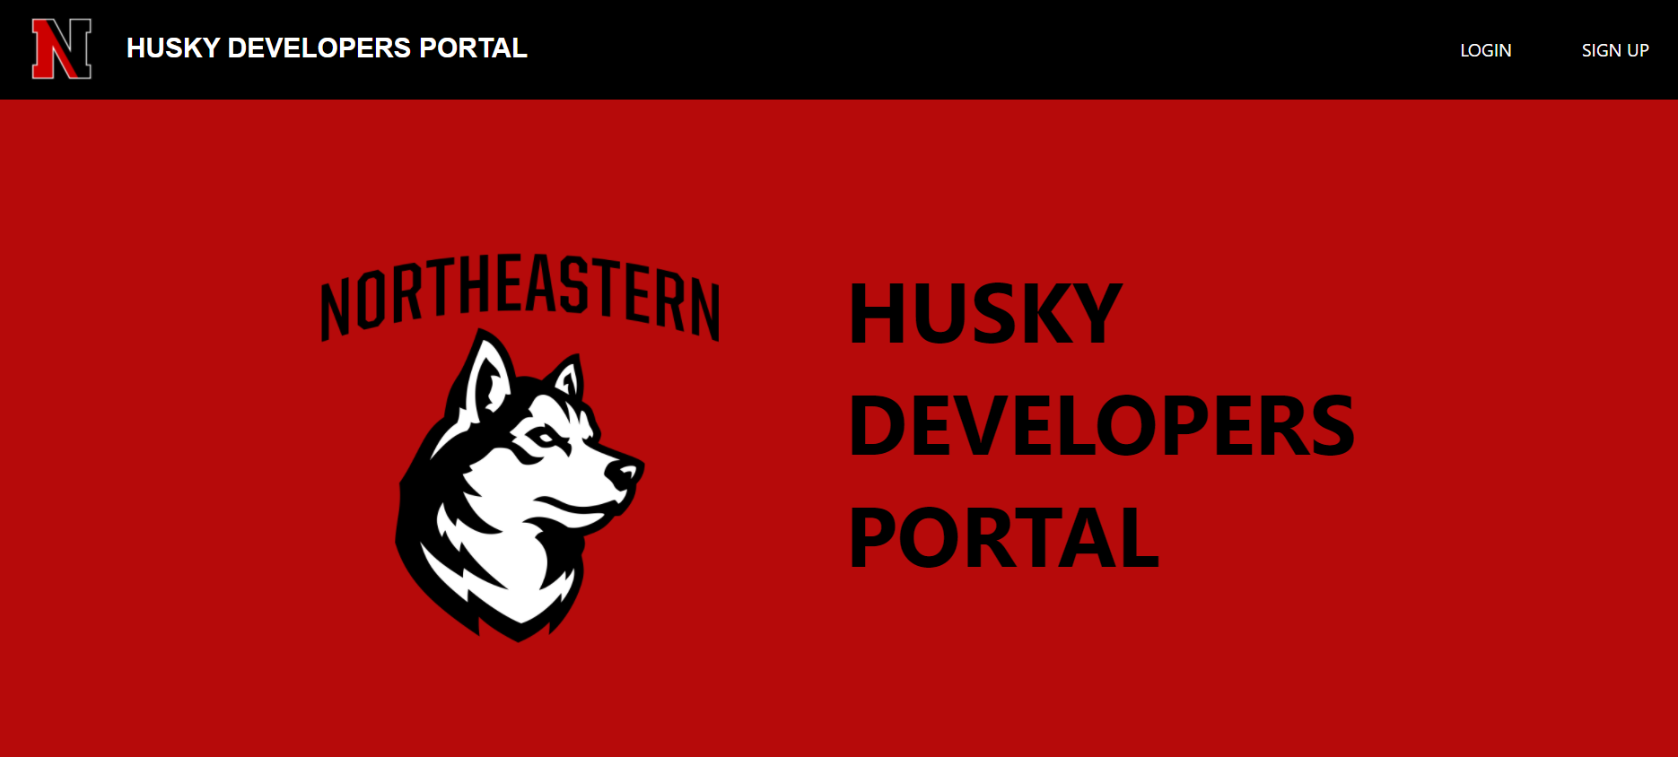

Slide 8
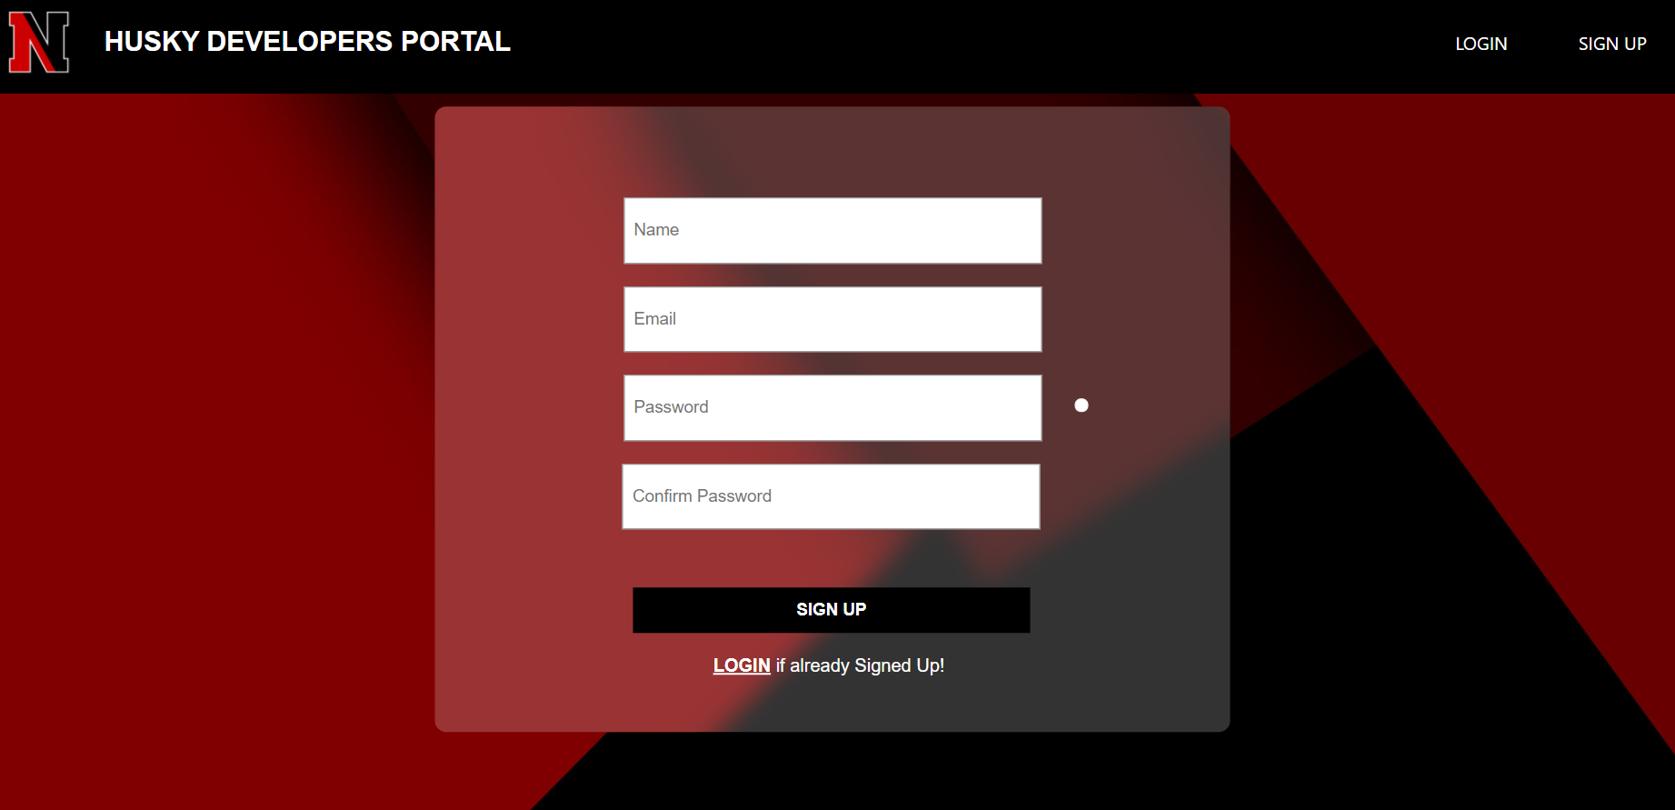

Slide 9
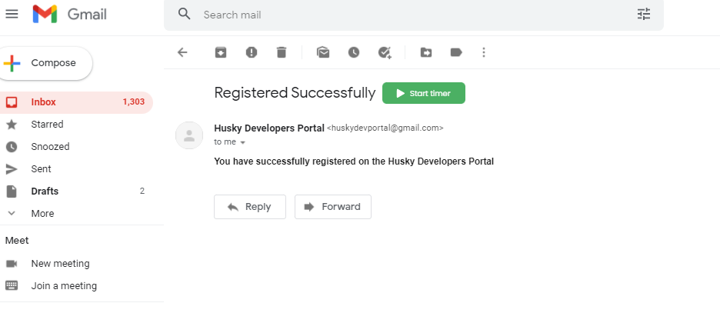

Slide 10
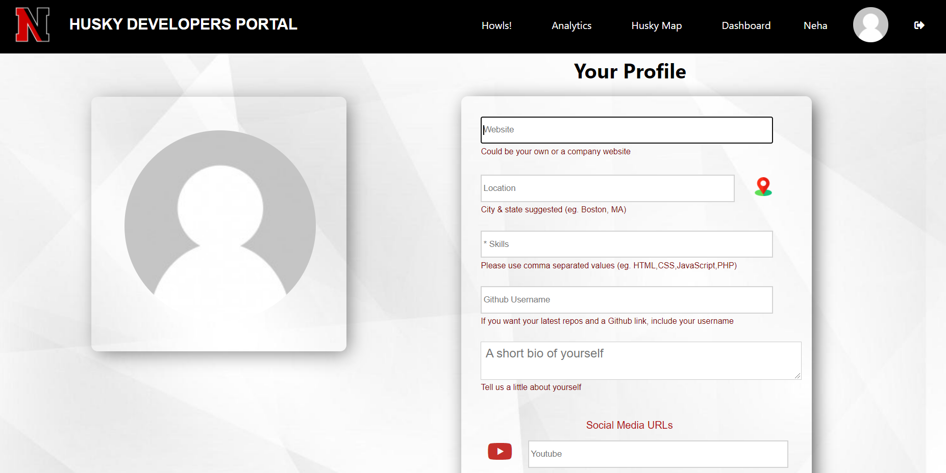

Slide 11
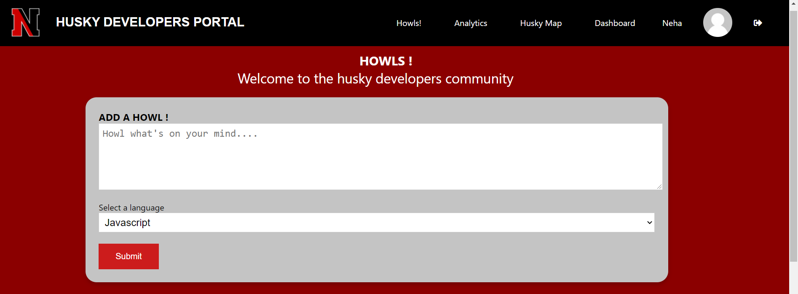

Slide 12
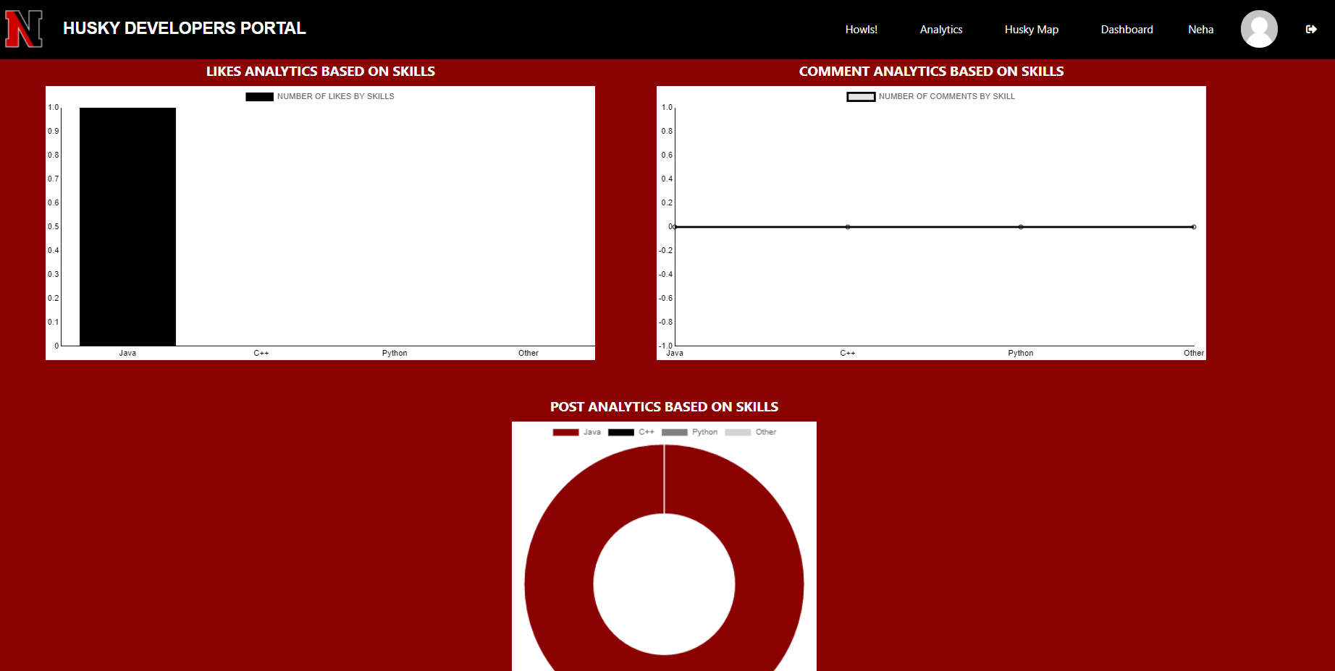

Slide 13
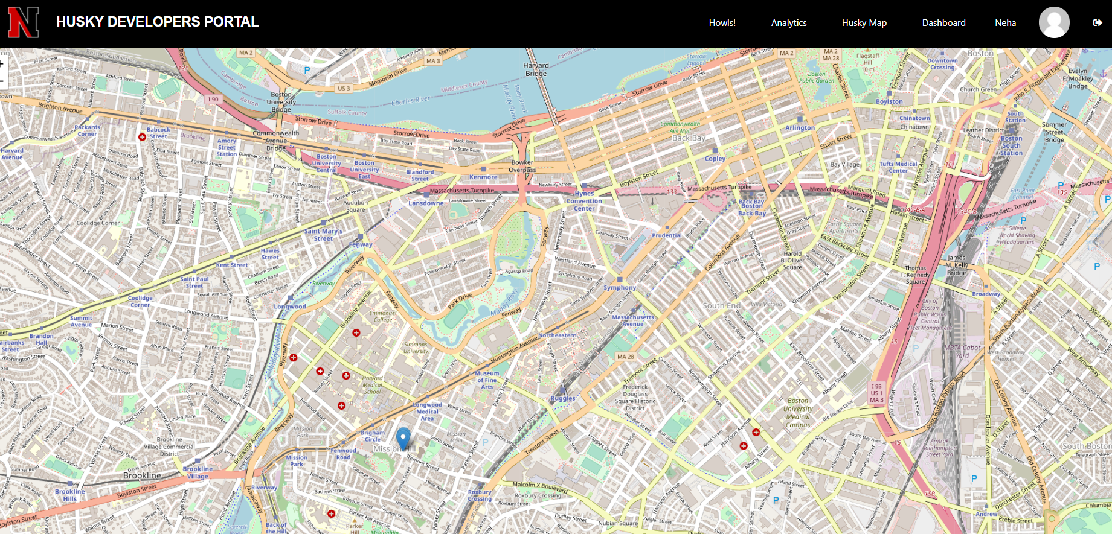

Slide 14
THANK YOU

